Slide 1
Extensibility Framework
September 2023

Slide 2
Agenda
Overview
High level Architecture
How its deployed in our Lab
Features of Extensibility Framework
Overview of Workbench
Simple version , enquiry creation
Config Micro service
API Creation using IRIS Workbench
Data Extension
API Inheritance
Auto Propagation
Reg Ex
Python Script
Virtual Table Micro Service
Rules Engine
Adapter MS

Slide 3
Prerequisite
You should have transact knowledge
Its good to have knowledge on the following,
Micro services
Python
RegEX
Camel
XSLT
JOLT
Etc.,

Slide 4
Overview of Extensibility Framework
Extension of Transact
Develops around the periphery of the system but not inside transact
Zero Impact on Core layer
Low Code / No Code
Notes:
Most of the code customization is done outside the transact
For experienced guy – Unlearn the few things, for juniors – Its new learning.

Slide 5
High Level Architecture flow of various components
Key Cloak (IM)
DSF Workbench
API Workbench
ODS Workbench
Infrastructure MS
Config
Temenos Packager - DFS
API Framework – IRIS APIs
Virtual Table
DFS – Repo (Optional)
Adapter
Transact / TAFJ
Rules Engine
Business MS
Party
Holdings
Temenos Data Hub
Data Event Streaming
Events
Events
And more
Events / Topics
Arrangement
Lending
Notes:
DMN - Decision Model & Notation

Slide 6











Deployment Model in our Lab
Linux Box
transact
Kubernetes (K8s)
genericconfig
App
Web
API
activemq
kafka
Nginx - Ingress
ms-adapterservice
ms-virtualtable
Consumers
Temenos web components:
Docker setup
Registry
BrowserWeb
Transact
Micro Services
Active MQ
Images
UXP Browser
Transact pre-image kits
Temenos Micro Services
Database
JPBM Rules Engine
Active MQ
DSF
Containers
Kind – K8s Clusters
Registry
Database
Kony Fabric
JBPM (Drools)
Workbench
IRIS18
Persisted
Storage
Frameworks & Tools:
Java
Docker Compose
Kube CTL
Helm
Notes:
Ingress image is taken from registry.k8s.io
Kafka image is taken from quay.io

Slide 7
Complete Step by Step Installation – Blue book Link
http://10.232.210.19:8090/display/temenostech/On+Kubernetes+%28K8s%29+on+Prem
Dev Ops – Automation
We are in the process of automating all the steps in our Lab using Ansible and Terraform.

Slide 8
Key Features of Extensibility Framework
Data Extensions
Extending the data model using Local ref and Local Ref Table
Data Validation and Defaulting
Configuration of Rules to validate and default IRIS API request fields
Uses Rules Engine / RegEx / Python Script
Integrations
Application specific configuration via work bench or Browser
Reporting
Application
API / Event Framework
Adapter Micro services
Reporting via Operational Datastore / TDH

Slide 9
L3 Possibilities – Functional points
Function Points | EF Component Reference | EF Solution | Cognizant Comments
Local Reference Field Creation | Data Extension | Temenos Work Bench
Local Application Creation | Data Addition | Virtual Table Micro service | Based on requirement , we might also end up using EB.TABLE.DEFINITION for L3 application
Field Default / Validation | Validation and Payload Enrichments | Rules Engine (Drools), Regular Expression(Regex) , Python Script
Updating Local Application | Python Script | Python Script | Need to use Rest APIs for updating the applications, it can also be Transact application
Application Exits (AA, TPH, Wealth) |  |  | Whitelist
L3 Services / COB | Close of Business extension | L3 Java API Scheduler | Traditional TSA.SERVICE developed using Java and use TSA.SERVICE.COB
New Version for UXPB / API | API addition and Extension | Temenos Workbench
New Enquiry for UXBP / API | API addition and Extension | Temenos Workbench
Nofile Enquiries / Reporting | Reporting (TDH) | ODS – API | SQL ( Semantic Query layer) – Can create the APIs to fetch the data from Operational Data Store
Interfaces / Events | Adapter Micro Service | Adapter Micro Service
Delivery related Components ( DE.MESSAGES, SWIFT, Statements etc.,) |  | Whitelisted
You need to get the concurrence from Temenos EF advisory on your design

Slide 10
Let's do a deep dive in to EF

Slide 11
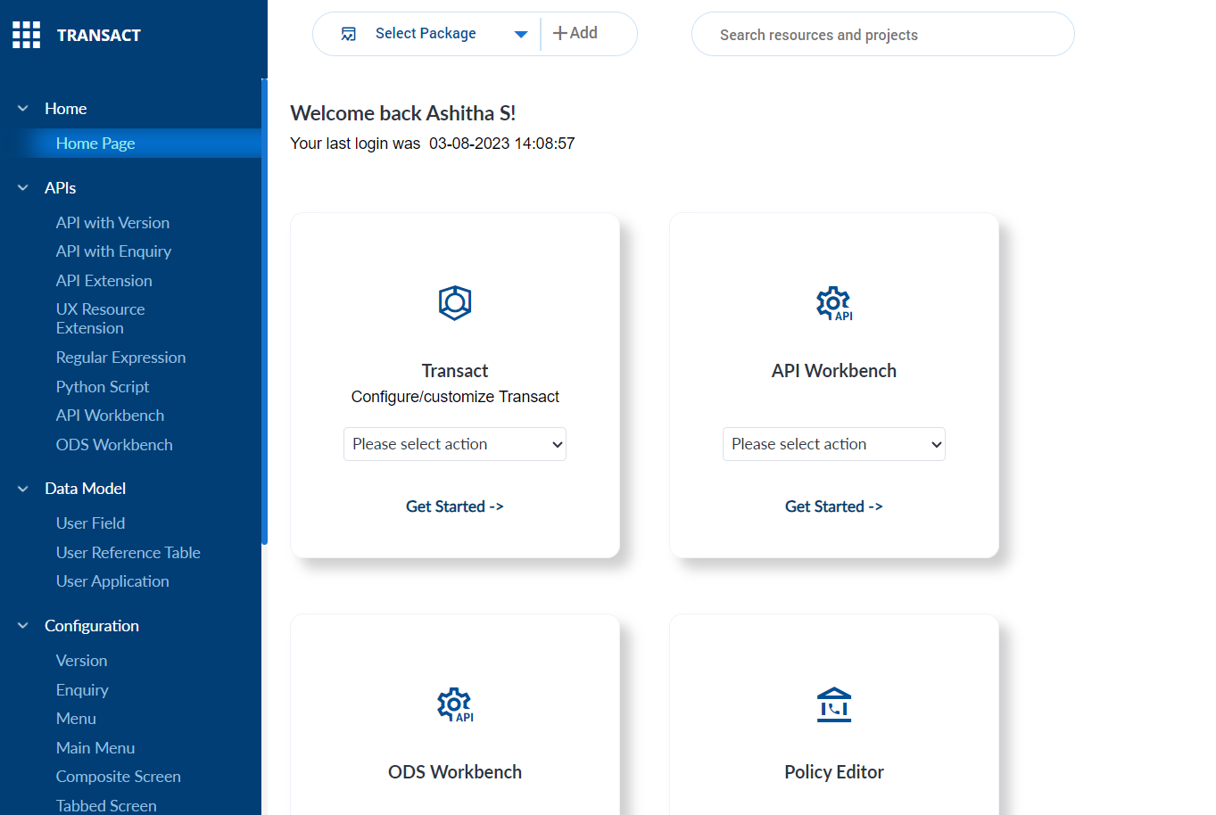
Work Bench Overview
A web-based UI , for your configuration , Managing the package for all temenos products.
Profiles can be created
All in one place – Transact version, enquires, API Workbench, ODS Workbench , Virtual table, Config MS , Adapter MS
Also included the packager to promote the changes to higher environment
Work Bench is only for Dev environment. For package deployments, we need Packager APIs- Example : dsf-iris.war

Slide 12
Jump into Working Session
Simple Version Creation
Simple Enquiry Creation
Dsf-packager

Slide 13
Config Micro Service
Stores and Manages the config in a centralized location
Configurations are grouped in to a groupID
Versions can be maintained
Used by all services
You can create your own config
http://cognizantlabr23.southeastasia.cloudapp.azure.com/ms-genericconfig-api/api/v2.0.0/system/configurationGroups/{congiguration group id}/configuration/{configuration id}
Sample Config Format
{
"id": “ConfigurationId",
"name": “Name of your Configuration",
"version": "1.0.0",
"configData": {
"data": {
“Key1": “Value1“,
“Key2": “Value2“,
“Key3": “Value3“,
},
"configType": "json"
}
}

Slide 14
List of Core Group Ids used in IRIS - API
GroupId | Description
com.temenos.irf.api.validations | Stores all validations related configurations like Regex and Rule mapping, regexConfig , Auto defaulting, extension script name in ms-config
com.temenos.irf.api.services | Stores all service XMLs
com.temenos.irf.api.swaggers | Stores all swagger Json files
com.temenos.irf.api.inventories | Stores all Inventory Json files
com.temenos.irf.api | Stores Sla Mappings and Environment details
com.temenos.irf.api.extensions | Stores python scripts
com.temenos.security.policies | Stores the policy related urls and retrieves policy XML files from config microservice during runtime for XACML validation of AP

Slide 15
Payload for com.temenos.irf.api.validations
Request:
http://cognizantlabr23.southeastasia.cloudapp.azure.com/ms-genericconfig-api/api/v2.0.0/system/configurationGroups/{com.temenos.irf.api.validations.<war_file_Name>}/configuration/{<domain>.<OperationId>}
Payload:
In the above payload, we add the configuration for api validation, the <war_file_Name> should be replaced by your war file name. Example: irf-extension-api and domain as your domain example party and OperationId . Example : createCustomer

Slide 16


Config MS in API Extension
com.temenos.irf.api.services.irf-provider-container
Is Extension Available ?
com.temenos.irf.api.wars
Rules Engine
Extensibility
Service XML
JBPM Drools
Swagger
com.temenos.irf.api. swaggers.irf-provider-container
Operation Id
Inventories
Config MS
Extension Details
Regex Engine
com.temenos.irf.api. validations.irf-provider-container
com.temenos.irf.api. inventories.irf-provider-container
com.temenos.irf.api. validations.irf-provider-containerv
Python Engine
com.temenos.irf.api.extensions.irf-provider-container
Env : temn.config.service.base.pathurl
IRIS War File – Irf-provider-container
API – End point
Provider Container – Core Engine
OFS - Engine
Transact
Service XML
Swagger
Inventories
IRIS API - Flow

Slide 17
Customer Onboarding
Bank requires a simple Customer Onboarding API with tags ShorName , Name , Street , Sector , Language

Slide 18
Creating API using Work Bench
Steps Involved in Traditional method
Create a version using putty or Browser
Create a provider API using irf-web-client
Generate the artifacts (api docs , swagger , inventory etc)
Create a Service Container.
Update the service jar to your provider conatiner
Steps Involved:
Create an API Version or Enquiry
Create Provider API using Iris Work Bench
No need to rebuild your war file – Inventories and API Docs are stored in Generic Micro Service
Prerequisite
Create Config in MS config your war file : In below example we have used irf-extension-api
{
"id": "irf-extension-api",
"name": "irf-extension-api API war",
"version": "1.0.0",
"configData": {
"data": {
"core": "false"
},
"configType": "json"
}
}
http://cognizantlabr23.southeastasia.cloudapp.azure.com/ms-genericconfig-api/api/v2.0.0/system/configurationGroups/com.temenos.irf.api.wars/configuration/irf-extension-api

Slide 19
Creation of API – Working Session

Slide 20
Customer Onboarding
Bank requires a simple Customer Onboarding API with tags ShorName , Name , Street , Sector , Language
Bank is expanding its operations in United Sates of America and need a separate API for its US region with all features as their base API and would like to add region specific functionalities to the API.
US users would like to add the HIDTA and HIFCA related information to the API
High Intensity Drug Trafficking Area
High Intensity Financial Crime Area
Based on postal code , customer will be flagged for Risk Analysis . So, need additional fields to store postal code, HIDTA and HIFCA .

Slide 21
API Inheritance
Inheritance allows an API to take on the attributes and behavior of its parent API.
Child API can have its own field apart from the field that has been inherited.
Allows you to change the labels , but you cannot remove any of the parent attributes.

Slide 22
Data Extension
Extending the transact data model by enabling the additional fields and application.
User Field
User Field Reference
User Applications
Nothing but Local Reference and Local Reference Table
Instead of L3 templates, you should start using the ETD – EB.TABLE.DEFINITION . Use this only when you need to get input from Users – (Example – If you need to create a version for bank users)

Slide 23
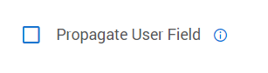
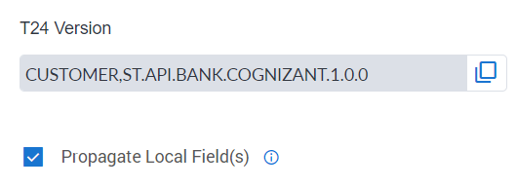
Auto Propagation
Inclusion of any new user defined fields without any modification of war file.
Key Value Pair
Should be enabled at user field level and at API level.
Field level Flag
At Api level

Slide 24
Working Session to create Local ref and new US API

Slide 25
Recap
Overview
High level Architecture
How its deployed in our Lab
Features of Extensibility Framework
Overview of Workbench
Simple version , enquiry creation
Config Micro service
API Creation using IRIS Workbench
Data Extension
API Inheritance
Auto Propagation
Reg Ex
Python Script
Virtual Table Micro Service
Rules Engine
Adapter MS

Slide 26
Customer Onboarding
Bank requires a simple Customer Onboarding API with tags ShorName , Name , Street , Sector , Language
Bank is expanding its operations in United Sates of America and need a separate API for its US region with all features as their base API and later on would like to add region specific functionalities to the API.
US users would like to add the HIDTA and HIFCA related information to the API
High Intensity Drug Trafficking Area
High Intensity Financial Crime Area
Based on postal code , customer will be flagged for Risk Analysis . So, need additional fields to store postal code, HIDTA and HIFCA .
4. Zip Code should be in US Postal code Format (NNNNN-NNNN)

Slide 27
API Extension – Reg EX
Regular Expression – Reg Ex
A sequence of characters that define a pattern. The pattern can be used for searching or to do a match.
Example : eMail : ^([a-zA-Z0-9_\\-\\.]+)@([a-zA-Z0-9_\\-\\.]+)\\.([a-zA-Z]{2,5})$
US Zipcode : ^[0-9]{5}(-[0-9]{4})$
https://regex101.com/ - Can be used to test the Reg Ex Expression
EF – Steps Involved
Create a Reg Ex record in config MS
Group Id - com.temenos.irf.api.validations.<war-file-name>
CofigId - regexConfig
Attach the Reg Ex to your Operation Id
Group Id - com.temenos.irf.api.validations.<war-file-name>
ConfigId – Operation Id

Slide 28
How to find the operation Id
Operation Id
All the APIs will have the operation Id which defines the operation that it performs. All the Extensions will be linked to a particular operation Id.
IRIS API
Will be present in your swagger document .json
http://cognizantlabr23.southeastasia.cloudapp.azure.com/irf-extension-api/api/v1.0.0/meta/apidocs/party-v1.0.0
2) If stored in MS config , you can get the swagger document using below url
http://cognizantlabr23.southeastasia.cloudapp.azure.com/ms-genericconfig-api/api/v2.0.0/system/configurationGroups/com.temenos.irf.api.swaggers.irf-extension-api/configuration/
UXP Browser
The operation Id should be created for UXP.
ConfigGroupId : com.temenos.irf.uxpb.resource.mapping
ConfigId : operationIds

Slide 29
Sample URL :
http://temenoscoects.eastus.cloudapp.azure.com/ms-genericconfig-api/api/V2.0.0/system/configurationGroups/com.temenos.irf.uxpb.resource.mapping/configuration/operationIds
Payload:
{ "id": "operationIds",
"name": "resource mapping with operationId",
"version": "1.0.0",
"configData": {
"data": {
"resourceOperationIdEntries": [
{
"resource" : "FUNDS.TRANSFER I",
"operationId" : "createPaymentUxpb"
}
]
},
"configType": "json"
}
}
The above Payload will create the operation Id called createPaymentUxbp for UXP operation which can be used later to link the extensions.

Slide 30
Working Session for Reg EX

Slide 31
Customer Onboarding
Bank requires a simple Customer Onboarding API with tags ShorName , Name , Street , Sector , Language
Bank is expanding its operations in United Sates of America and need a separate API for its US region with all features as their base API and later on would like to add region specific functionalities to the API.
US users would like to add the HIDTA and HIFCA related information to the API
High Intensity Drug Trafficking Area
High Intensity Financial Crime Area
Based on postal code , customer will be flagged for Risk Analysis . So, need additional fields to store postal code, HIDTA and HIFCA .
Zip Code should be in valid US postal code Format
Make the HIDTA and HIFCA code Mandatory, if Zip Code is entered

Slide 32
Python Script
Complex Validations and business logic can be achieved via Python Script.
This feature allows you to extend the core framework without impacting the core layer.
The scripts are stored in the Generic Micro service as base64 format.
Steps Involved:
Create a Python script and store it in generic Micro Service
Link the script to the API or UXP resource using operation ID
Pre-requisite
temn.config.service.base.pathurl , environment variable should be configured .
conf.ms.url.host.groupIdPrefix, Should have the validation group id. Or leaving it blank will initialize all the core group ids.
In the respective provide container add the depdency in jboss-deployment xml like below to identify the class paths.
<jboss-deployment-structure xmlns="urn:jboss:deployment-structure:1.2">
<deployment>
<dependencies>
<module name="com.temenos.validation" />
</dependencies>
</deployment>
</jboss-deployment-structure>
The jar files that are being used in python script should be in lib path:
Example: module.xml for validation

Slide 33
Working Session Python Script

Slide 34
Virtual Table MS

Slide 35
Customer Onboarding
Bank requires a simple Customer Onboarding API with tags ShorName , Name , Street , Sector , Language
Bank is expanding its operations in United Sates of America and need a separate API for its US region with all features as their base API and later on would like to add region specific functionalities to the API.
US users would like to add the HIDTA and HIFCA related information to the API
High Intensity Drug Trafficking Area
High Intensity Financial Crime Area
Based on postal code , customer will be flagged for Risk Analysis . So, need additional fields to store postal code, HIDTA and HIFCA .
Zip Code should be in valid US postal code Format
Make the HIDTA and HIFCA code Mandatory, if Zip Code is entered
Remove the manual intervention and update the codes based on the Zip Code that we get in the request

Slide 36
What we need to automate the default of HIDTA and HIFCA
Traditional Steps
Create a L3 table and store the HIFCA and HIDTA code based on the postal code
Attach a validation Rtn to default the values.
In Extensibility Framework,
Create a virtual table
Use the python preprocess to populate the value based on the postal code.

Slide 37
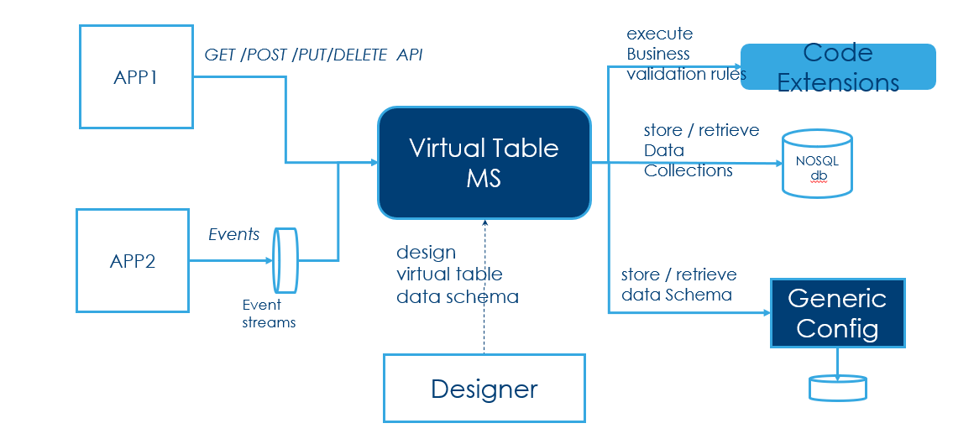
Virtual Table
Flow of Virtual table MS
Virtual table micro service, enables the data extension to maintain the custom data collection.
Store the data in JSON format
Virtual table should be used in place of L3 tables.
Using virtual table, you cannot create any version. Hence you will not be able to use this for getting data from users nor to get data for traditional enquiries.
***Image reference from Temenos docs.

Slide 38
Virtual Table Continued
Design time APIs
For sample payload refer temenos docs : https://docs.temenos.com/docs/Solutions/Technology/Extensibility_Framework/VirtualTable/VirtualTable/APIs/c_APIs.htm
Description | Method | APIs
Create Data Collection | POST | /domains/{domainId}/VirtualTables/{VirtualTableId}
Get Data Collection | GET | /domains/{domainId}/VirtualTables/{VirtualTableId}
Get Schema | GET | /domains/{domainId}/VirtualTables
Update Data Collection | PUT | /domains/{domainId}/VirtualTables/{VirtualTableId}
Delete Schema of the latest version | DELETE | /domains/{domainId}/virtualTables/{virtualTableId}
Delete Schema of particular version | DELETE | /domains/{domainId}/virtualTables/{virtualTableId}?versionId=x.x.x
Delete all the versions | DELETE | /domains/{domainId}/virtualTables/{virtualTableId}? deleteAll=true

Slide 39
Virtual Table Continued
Run time APIs
For sample payload refer temenos docs : https://docs.temenos.com/docs/Solutions/Technology/Extensibility_Framework/VirtualTable/VirtualTable/APIs/c_APIs.htm
Description | Method | APIs
Create Data Collection Record | POST | /domains/{domainId}/VirtualTables/{VirtualTableId}/records
Get All records | GET | /domains/{domainId}/VirtualTables/{VirtualTableId}/records
Get Data collection Record | GET | /domains/{domainId}/VirtualTables/{VirtualTableId}/records/{recordId}
Update Data Collection Record | PUT | /domains/{domainId}/VirtualTables/{VirtualTableId}/records/{recordId}
Delete the Data Collection | DELETE | /domains/{domainId}/VirtualTables/{VirtualTableId}/records/{recordId}

Slide 40
Features of Virtual Table
Validation Data Types
Script Extension
Command Ingester
Configuration based Ingester
Custom Selection Criteria

Slide 41
Validation Data Types
Basic Validation Data Types:
Virtual table validates the basic data types like String , Integer , Boolean, Object, Number by defining the type in Schema.
Example:
“description”: {
“type”: “string”
}
Static Expression Validation
You can define the schema based on RegEx to validate. For example,
“email” : {
“type” : “String”
“pattern”: “^([a-zA-Z0-9_\\-\\.]+)@([a-zA-Z0-9_\\-\\.]+)\\.([a-zA-Z]{2,5})$ ”
}
Lookup Validation
In this type of validation, virtual table will validate the field against the record in another virtual table. Similar to drop down tables in Transact.
“currency” : {
“type”: “String”
“lookup”: “payments.currency”
}

Slide 42
Script Extension
Virtual table allows you to attach the python scripts hooks to do the additional validations and add business logics.
Like other extensions, python scripts are stored in Generic Micro Service in base64 encoded format . It will be reterived and executed during the run time.
Configuration Group Id to add python script : com.temenos.microservice.extensionfunction
Example :
https://cognizantlabr23.com/ms-genericconfig-api/api/v2.0.0/system/configurationGroups/com.temenos.microservice.virtualtable.extensionfunction/configuration/customer.address.retrieverecord
In the above example, we are attaching the python script to virtual table called address in customer domain for GET request.
API Type | Configuration Id
POST api | <domainId>.<VirtualTableId>.createrecord
GET API | <domainId>.<VirtualTableId>.retrieverecord
PUT API | <domainId>.<VirtualTableId>.updaterecord
DELETE API | <domainId>.<VirtualTableId>.deleterecord

Slide 43
Command Ingester
Cloud event JSON can be processed using the command Ingester feature of Virtual table.
Virtual table consumes the events in kafka topic – virtualtable-inbox-topic and updates the corresponding virtual table. The status of each events are updates in ms_inbox_events as processed or failed.
Sample Cloud JSON for injection of Virtual table
{
"specversion":"1.0",
"type":"virtualtable.createDataCollectionRecord",
"subject":"command",
"source":"https://temenos.com/microservice/cloudevents/ms-paymentorder",
"id":"4216e8-3ca-9-b-8833",
"time":"2018-04-05T17:31:00Z",
"datacontenttype":"application/json",
"data":{
"params":{
"domainId":[
"customer“
],
"virtualTableId":[
"creditcard"
]
},
"body":{
"recordId":"EXT-1226",
"data":{
"cardNumber":"123456789012345678901",
"customerId":"100100",
"cardType":"Visa",
"cardLastFourDigits ":"8901",
"expirationMonth":10,
"expirationYear":2022,
"currency":"INR",
}
}

Slide 44
Configuration based Ingester
Similar to command based Ingester, Virtual table supports JOLT based Ingester to do the transformation of the incoming payload.
The JOLT specification are stored in generic config microservice. Cofigruation Group ID : virtualtable.jolt and Config id is virtual table name.

Slide 45
Custom Selection Criteria
Virtual table supports the query parameter in the GET request.
This helps to retrieve the records based on the filters.
The following formats are currently supported,
Equal (=)
Not Equal (ne)
Greater Than (gt)
Less Than (lt)
Greater Than or Equal (gte)
Less Than or Equal (lte)
Example: /domains/person/virtualTables/customer/records?firstName=Alice
The above API fetches the records from virtual table customer which has FirstName as Alice.

Slide 46
Working Session for Virtual Table MS

Slide 47
Customer Onboarding
Bank requires a simple Customer Onboarding API with tags ShorName , Name , Street , Sector , Language
Bank is expanding its operations in United Sates of America and need a separate API for its US region with all features as their base API and later on would like to add region specific functionalities to the API.
US users would like to add the HIDTA and HIFCA related information to the API
High Intensity Drug Trafficking Area
High Intensity Financial Crime Area
Based on postal code , customer will be flagged for Risk Analysis . So, need additional fields to store postal code, HIDTA and HIFCA .
Zip Code should be in valid US postal code Format
Make the HIDTA and HIFCA code Mandatory, if Zip Code is entered
Remove the manual intervention and update the codes based on the input we get in the request
Update the Hidta and Hifca value from the consumer when we receive. The consumer streams the data when there is update / new postal codes.

Slide 48
How do we do it ?
Use the Configuration based Ingester feature of Virtual table to ingest the data into virtual table.
Steps Involved :
Post the Cloud Json data into the topic - virtualtable-inbox-topic

Slide 49
Drools – Rules Engine
Drools is from jboss JBPM which is a business automation tool kit. There are various features in JBPM, out which extensibility uses DMN ( Decision Model and Notation).
It can be run in same server as transact or in different server
You can do the validation / Default for UXP version or API version against a domain Id and Operation Id
Incase of validation , the rule engine should return Boolean. If you want to default , it should return a JSON object.

Slide 50
Working Session for Rules Engine – UXBP Extension

Slide 51
Adapter MS
Adapter Micro service provides the flexibility to integrate the Temenos applications to 3rd party service.
Scalable and driven by configuration – Transformation and Routing.
Uses Apache Camel
Can be designed using work bench

Slide 52
Adapter MS – Supported Patterns Out of Box
API 2 Events
Endpoint can be created to accept the data in JSON/XML and do transformation and deliver it to a streaming platform or JMS Queue
Events 2 API
Opposite of the above.
API 2 API
File Bulking
File Debulking
Subscribe for an event and consumes the message and translate each event in to an api call
An API exposed in adapter MS to call another API
Receives the data in events and batch events into a flat file. Files can be generated periodically
Read a flat file (CSV/JSON) and push the data to target system as an API

Slide 53
Adapter MS – In Simple workflow
Process Steps / Templates
Contains route xml and Input parameters required for it
Adapter Engine – MS
Runs the adapter ( Camel Route)
Triggered via API, Events, Scheduler
Adapter – Contains the input value for your template

Slide 54
Demo on Adapter MS

Slide 55
Thank you

